Slide 1

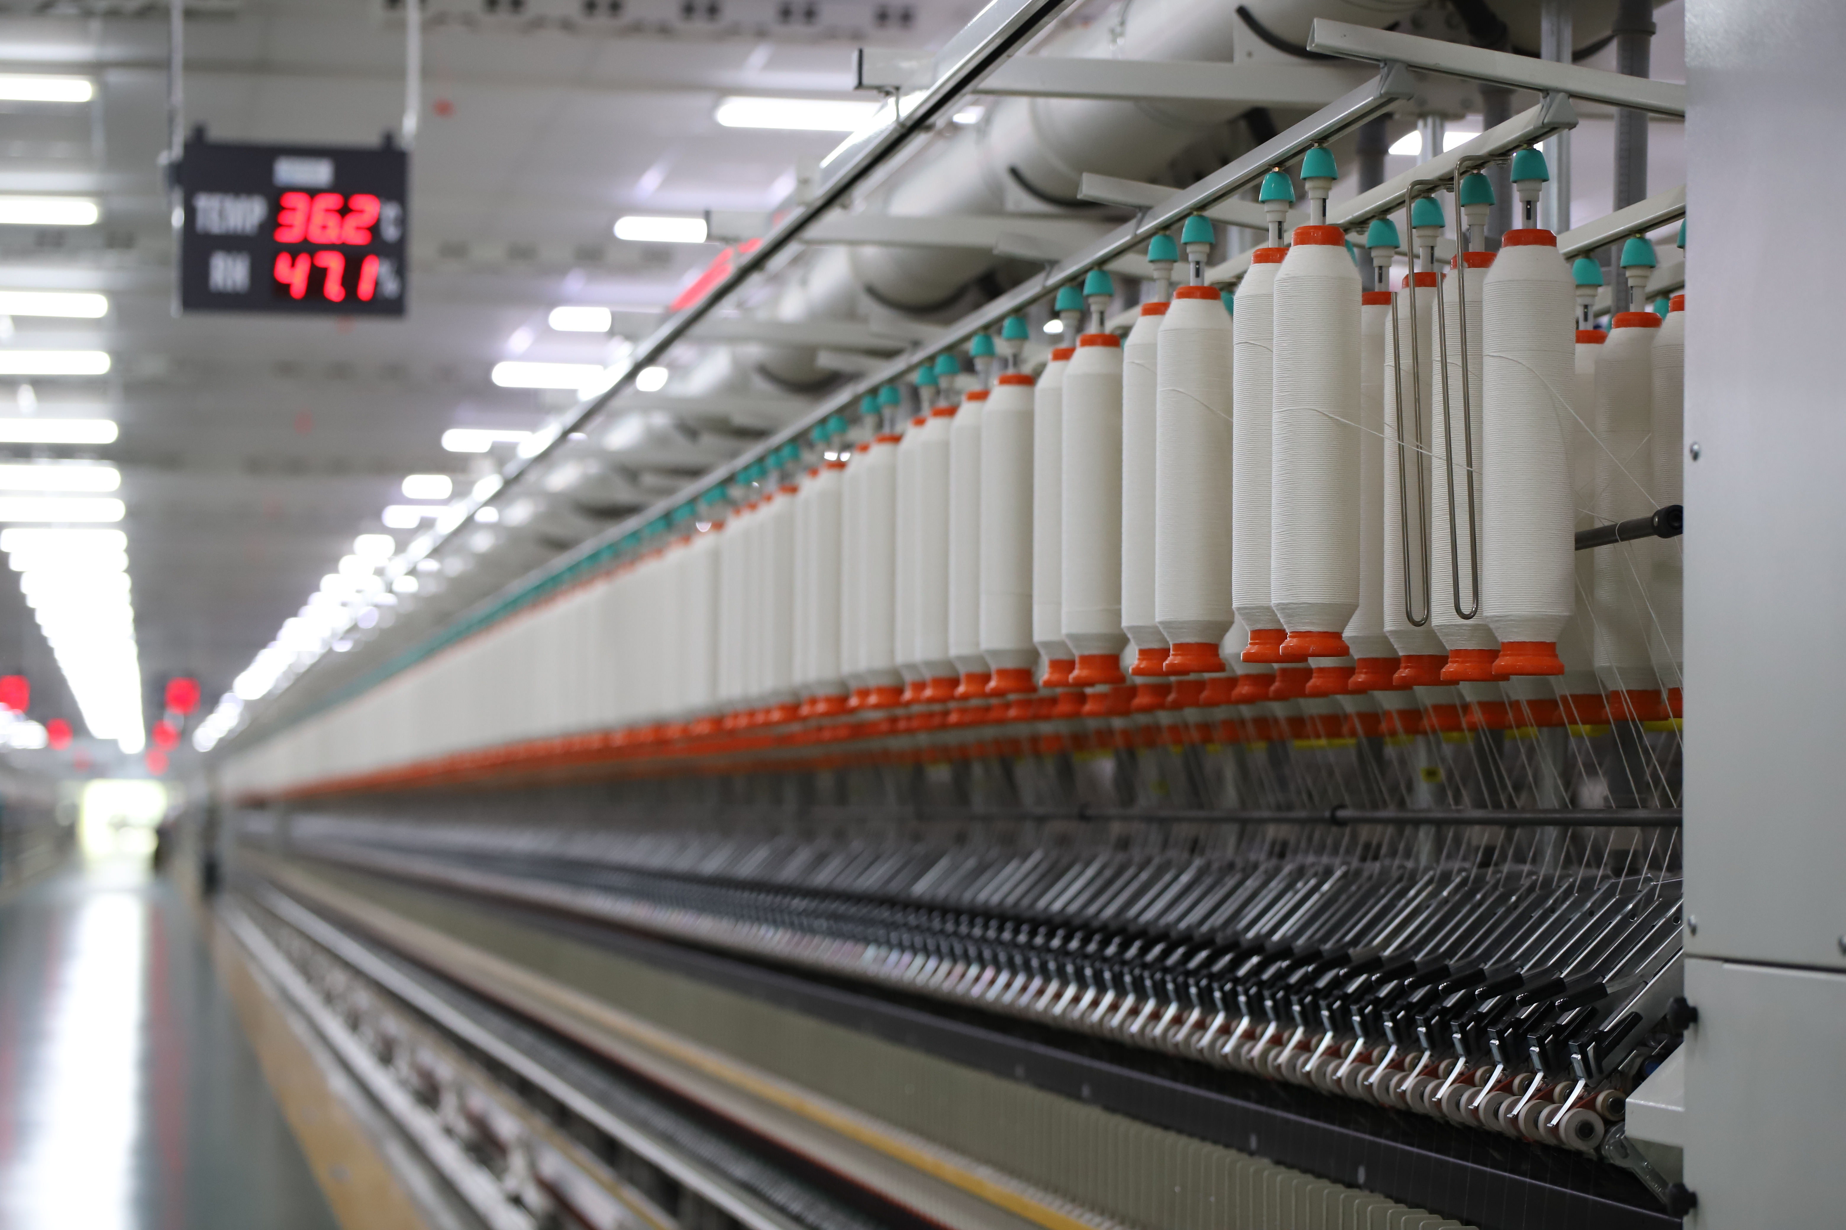
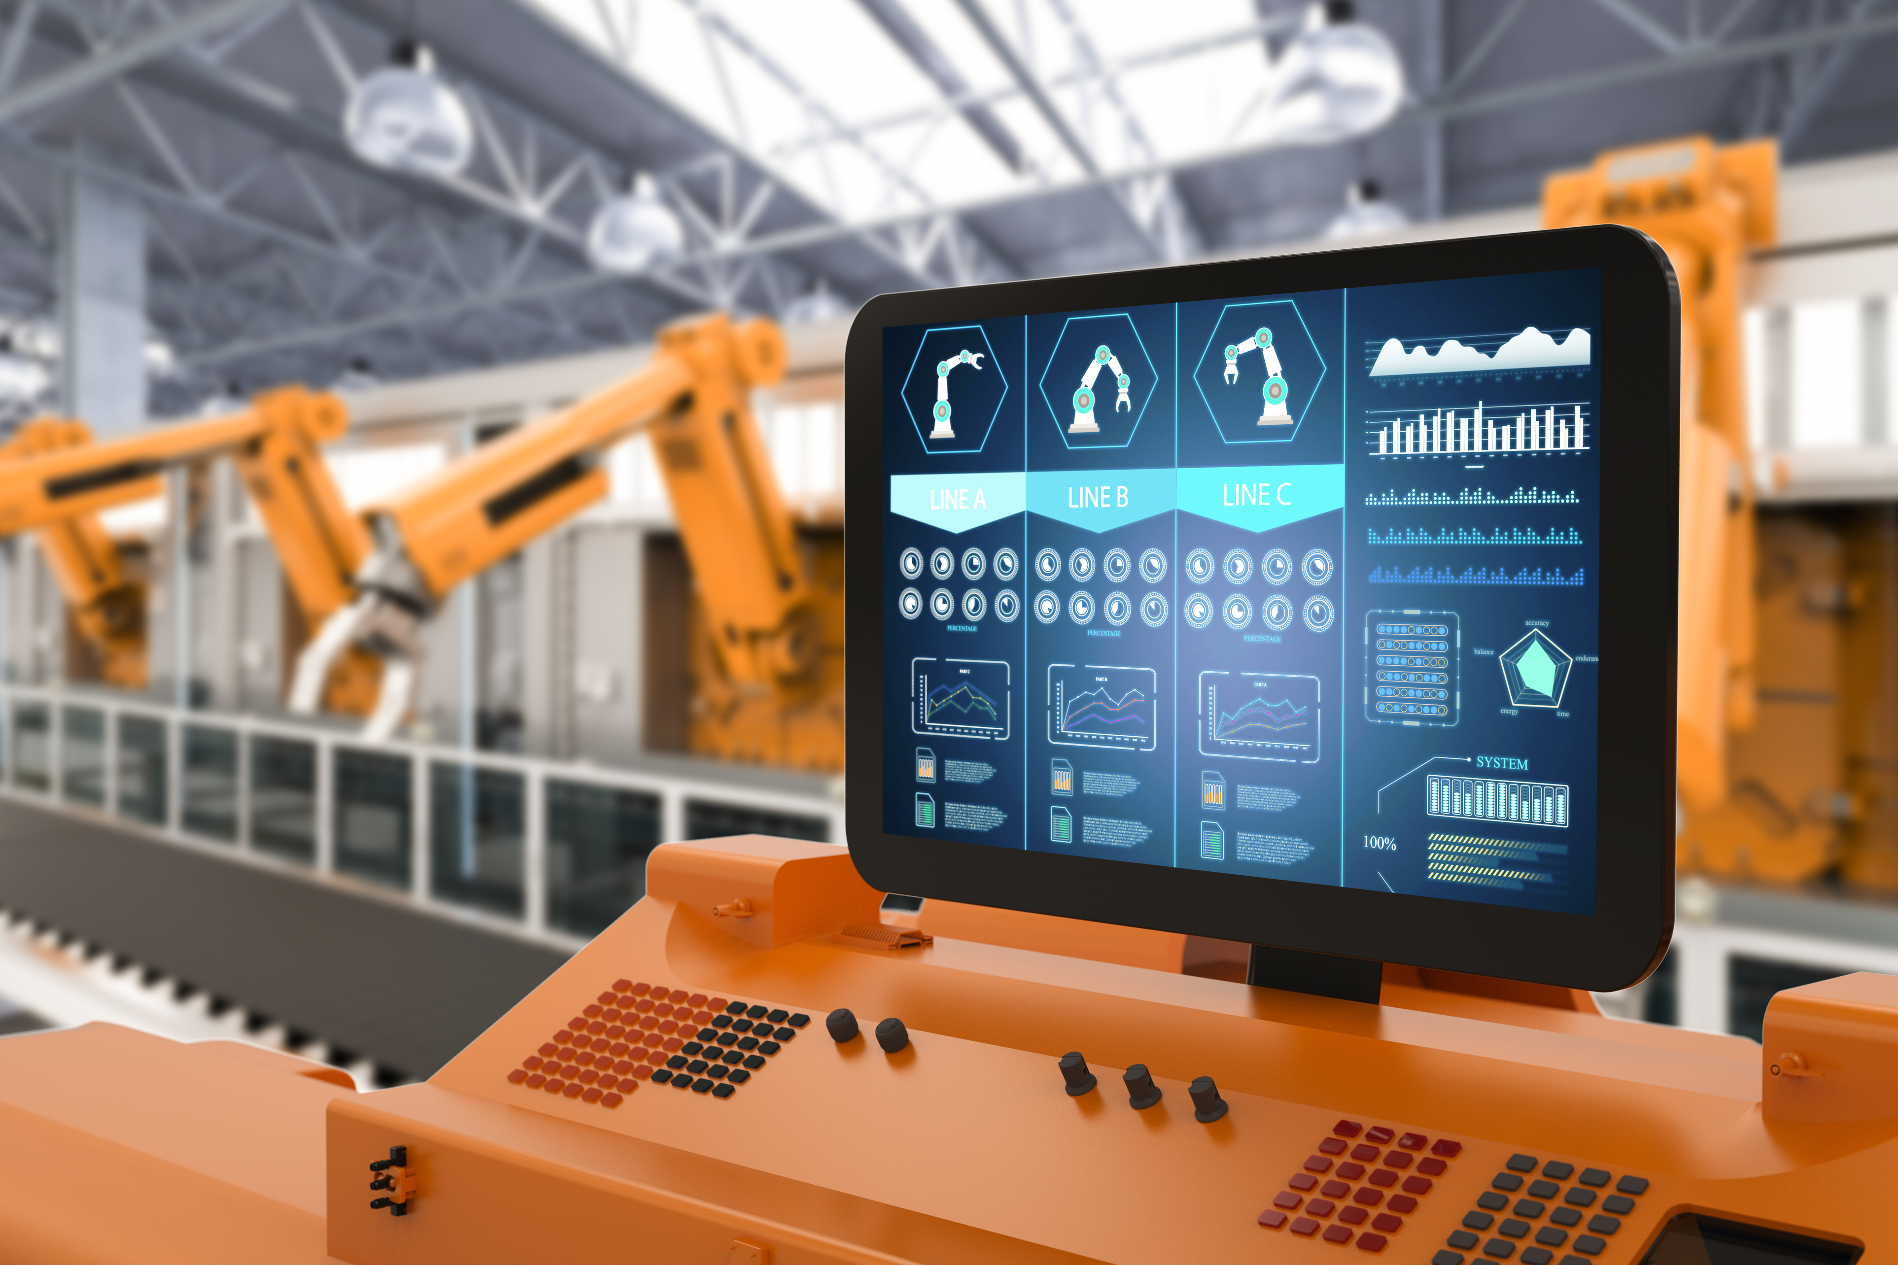
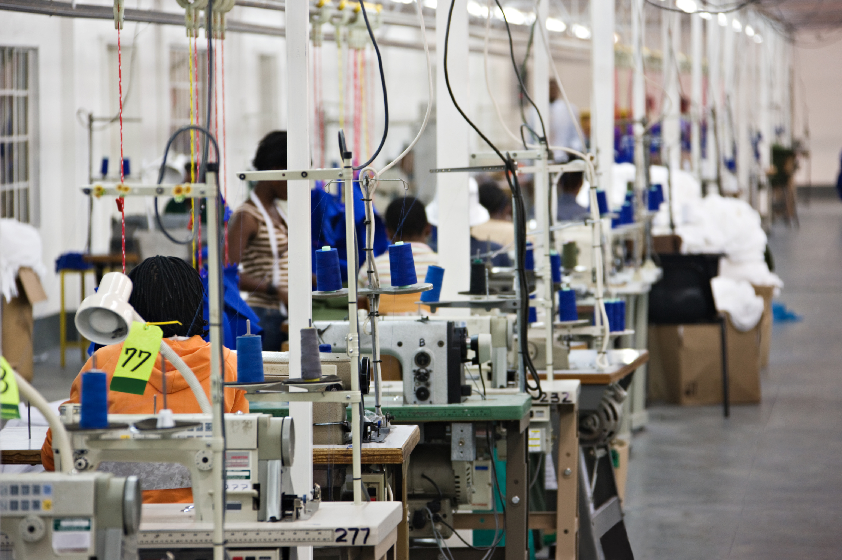





MANUTRACK FOR TEXTIFLOW
YAT525A_SHR3_DAT1_S2_DEPI3
GROWNEED DATA GEN
Data Analyst Specialist

Slide 2

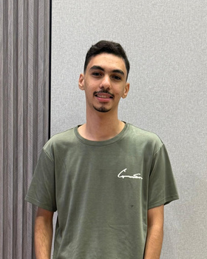



GROWNEED DATA GEN TEAM
Instructor
Mahmoud Adel Eraky
Eng. Kareem Bakly
FCI - ZNU, Data Analyst Specialist.
Abdulrahman Ali Shabn
Ahmed Abdalmaksoud Ali
FCI - ZU , Data Analyst Specialist.
Team Leader
FCI - ZU , Data Analyst Specialist.
Adham Walid Boghdady
Ahmed Mohammed Al-Sadiq
FCI - ZU , Data Analyst Specialist.
GIS , Data Analyst Specialist.
YAT525A_SHR3_DAT1_S2_DEPI3
MANUTRACK FOR TEXTIFLOW
Data Analyst Specialist

Slide 3
MANUTRACK FOR TEXTIFLOW
The High-Stakes World of Textile Manufacturing
The global textile industry, valued at approximately $1.10 trillion in 2024, is characterized by a complex, high-cost operational chain that demands precision. Profitability hinges on maximizing machine uptime, as any sudden failure results in severe financial hemorrhaging due to fixed costs like energy (consuming 800–900 kWh/hour on the spinning line) and idle labor. Our project addresses this critical challenge by leveraging data science to transform operations. We utilize advanced analysis of sensor data (Temperature, Vibration) to develop a predictive maintenance system.
YAT525A_SHR3_DAT1_S2_DEPI3
GROWNEED DATA GEN
Data Analyst Specialist

Slide 4

MANUTRACK FOR TEXTIFLOW
Vision & Strategic Alignment
Our project is not just a data analysis exercise; it is an integral part of a national endeavor to achieve Egypt's Vision 2030. We are focused on developing a predictive maintenance system, positioning this initiative as a vital intersection with the state's strategy to empower and modernize local textile manufacturing industries. This is achieved by reducing unexpected breakdowns, enhancing the manufacturing capacity of factories, and minimizing financial losses caused by machine downtime.
YAT525A_SHR3_DAT1_S2_DEPI3
GROWNEED DATA GEN
Data Analyst Specialist

Slide 5



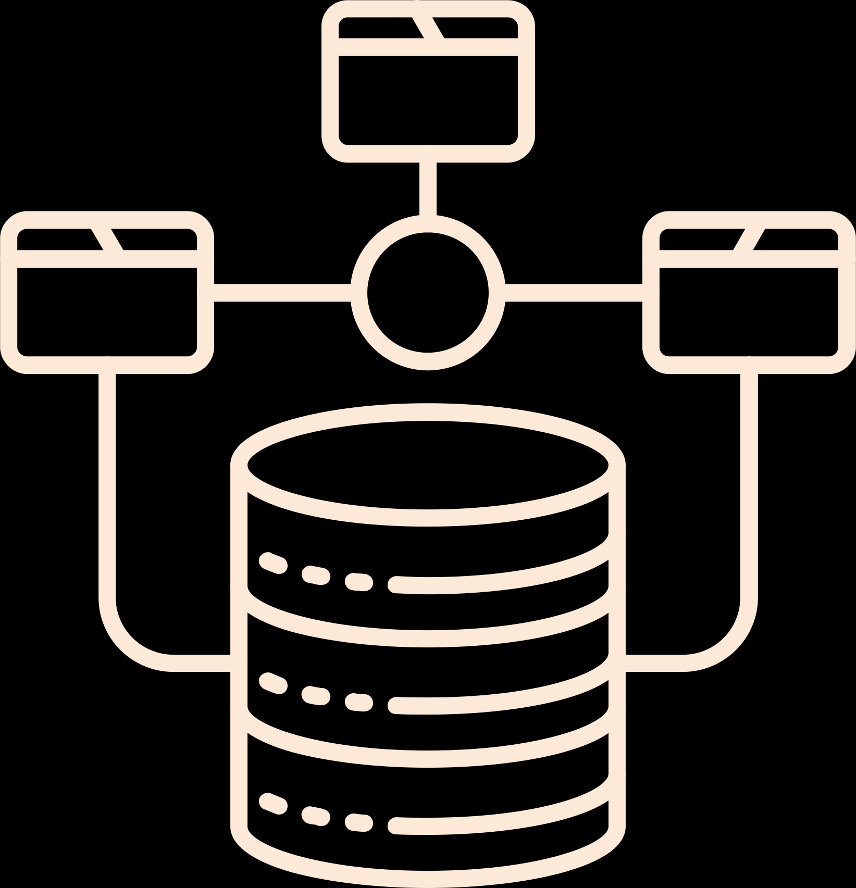

PROJECT STAGES
DATA
ACQUISITION
DATA
PREPARATION
EDA
DATA
MODELING
DATA
VISUALIZATION
YAT525A_SHR3_DAT1_S2_DEPI3
GROWNEED DATA GEN
Data Analyst Specialist

Slide 6

DATA ACQUISITION
Smart Manufacturing Monitoring Dataset
Dataset Profile & Key Features
Source Purpose: The dataset is designed to facilitate real-time process monitoring, predictive maintenance, and anomaly detection in industrial environments.
Scope: It contains 100,000 sensor records collected from 50 unique machines.
Data Types: The data simulates sensor readings, including parameters such as temperature, vibration, humidity, pressure, and energy consumption.
Timestamps: Sensor readings are recorded at 1-minute intervals.
Predictive Labels: The file includes anomaly flags, failure types, and a target column (maintenance_required), which indicates whether a machine requires maintenance.
YAT525A_SHR3_DAT1_S2_DEPI3
GROWNEED DATA GEN
Data Analyst Specialist

Slide 7

DATA PREPARATION
Key transformation steps were implemented within Power Query to ensure data integrity and generate actionable features:
Computed Columns (Feature Engineering): We enriched the dataset by adding dynamic classification columns derived from the original data, which are essential for analysis and filtering.
State Classification: Classification columns (e.g., [Vibration State], [Temperature State]) were created by associating raw sensor values ​​with specific, actionable ranges (Normal, Alert, Severe). This step allows for direct visual filtering of the data on dashboards.
YAT525A_SHR3_DAT1_S2_DEPI3
GROWNEED DATA GEN
Data Analyst Specialist

Slide 8

EXPLORATORY DATA ANALYSIS (EDA)
This phase was executed primarily using Python to validate data quality, understand statistical distributions, and visually identify major trends and anomalies before dashboard development.
Statistical Validation and Quality Check:
Data Integrity: The initial check confirmed that the dataset contains 100,000 records across columns with zero missing values (nulls). This validated the reliability of the sensor inputs.
Status Distribution: Generated pie charts to analyze the distribution of Machine Status (80.1% Normal vs. 10.1% Failed) and RED_Flag alerts (8.9% alerts). This confirmed the ratio of success/failure of the existing prediction model.
Categorical Breakdown: Confirmed the distribution of operational risk factors, such as High Humidity and Severe / Critical Vibration.
YAT525A_SHR3_DAT1_S2_DEPI3
GROWNEED DATA GEN
Data Analyst Specialist

Slide 9
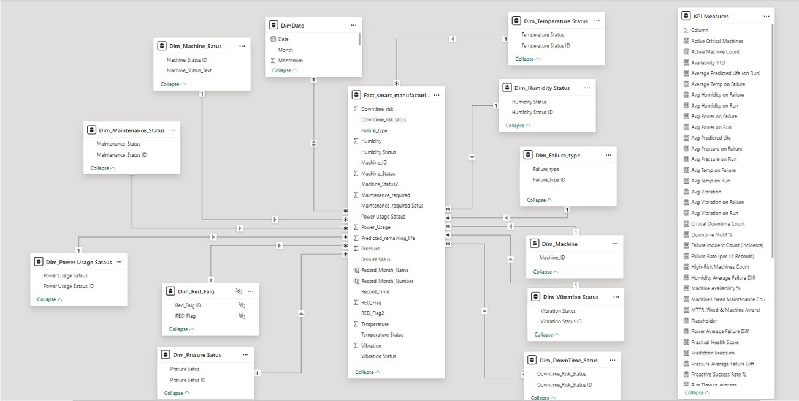
DATA MODELING
We established the foundational structure by moving to the Data Modeling phase.
Our Core Architecture: We utilized the Star Schema, which is the industry standard for BI reporting. This structure separates our data into Fact (measurements) and Dimension (descriptive) tables.
The Result: This architecture is crucial as it guarantees fast performance and, more importantly, ensures that our custom metrics and filtering work correctly.
YAT525A_SHR3_DAT1_S2_DEPI3
GROWNEED DATA GEN
Data Analyst Specialist

Slide 10

DATA VISUALIZATION
The final step focused on creating an intuitive and professional user interface (UI) to deliver the insights effectively to the management team.
Unified Theme and Branding:
A single, consistent corporate color theme was applied across all five dashboard pages to ensure a professional and cohesive user experience (UX). This consistency maintains the project's visual branding.
Goal: To present a unified and polished look and feel that enhances trust in the analytical results.
Specialized Pages (Deep Dives): The subsequent four pages are highly specialized.
Benefit: This structure allows executives to grasp the general situation immediately, while specialists can drill down into the deeper analytical results when needed.
YAT525A_SHR3_DAT1_S2_DEPI3
GROWNEED DATA GEN
Data Analyst Specialist

